Slide 1




Slide 2


SEWORLD – ELECTRIC SECTOR IN THE WORLD
Risks to Water Security
The importance of water resource regulation
Climate change, floods and droughts
March 22nd
Igor Ribeiro
Infrastructure Analyst / Project Manager
Ministry of Mines and Energy (Brazil)

Slide 3
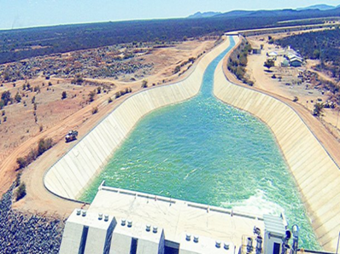
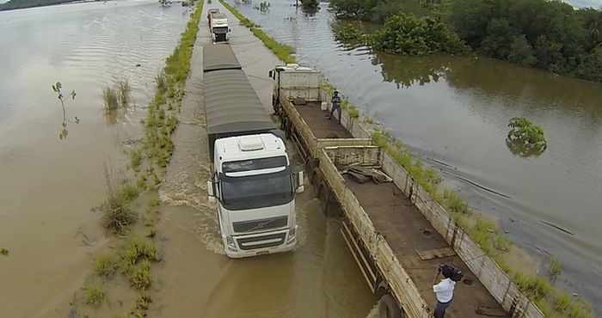
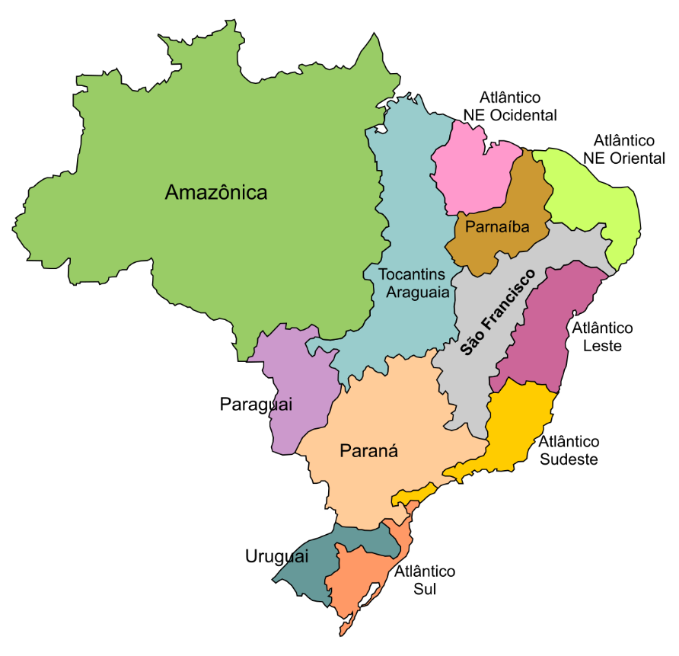
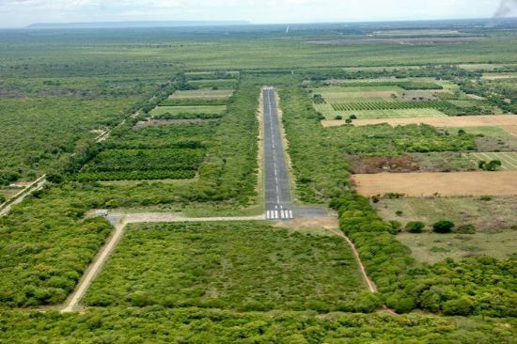
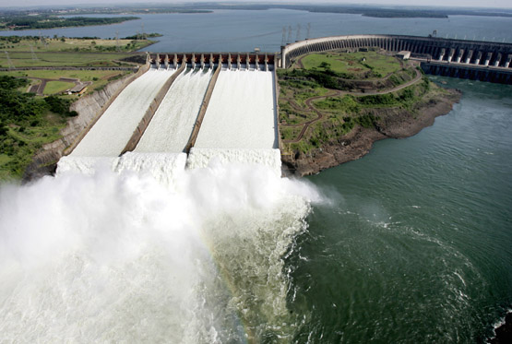
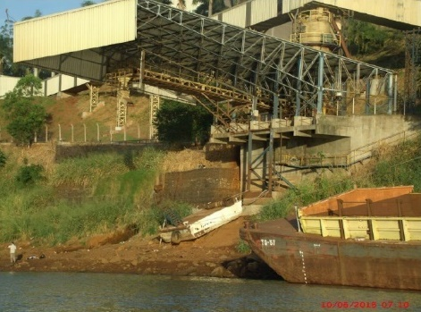
Brazil in the last years...

Slide 4
Brazil in the last years...
Water consumption has grown 30% in the last 5 years (ANA, 2014).
In 2010, the balance between supply and consumption was considered critical or very critical in 17% of Brazil's freshwater sources (ANA, 2013).
In 2012, urban distribution losses reached 37% (SNIS, 2012).
Source: ANA, 2014

Slide 5
The challenge of water regulation
  Ensure equity among different regions, sectors and users
  Compliance
  Stability mechanism
  Legal certainty
  Incentives to ensure efficient use and allocation
Preservation of the water infrastructure economic viability
Investment incentives of water infrastructure
Maximization of the water resources potential
Maximization of economic, social and environmental results
Achievement of strategic results: national, state and local governments
Achievement of ecological objectives
Reduction of sectors and users conflicts.

Slide 6
The challenge of water regulation
Water security to the users in accordance with their rights
Flexibility to the management to the new circumstances
  Sharing opportunities and risks

Slide 7
Water regulation and water security
What is the role of users sectors in improving water security?
What is the role of water regulation in improving water security?
Who should promote water regulation? Users sectors? ANA? CNRH? State managers? State water councils? Basin Committees?
What is the role of water grant?
Water regulation should consider users sectors operation, but responsibilities and risks must be shared.

Slide 8
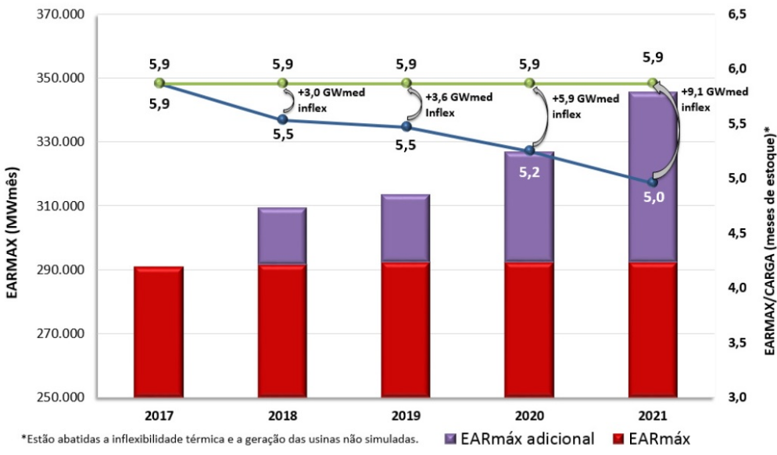
Reservoirs in Brazil: do we need more?
Put yourself in the brazilian energy consumers shoes... There are options to them.
Are there options to citizen? Are there options to replace water?
9.100 MWmed
30.000 MW in wind generation
Source: ONS, 2017

Slide 9
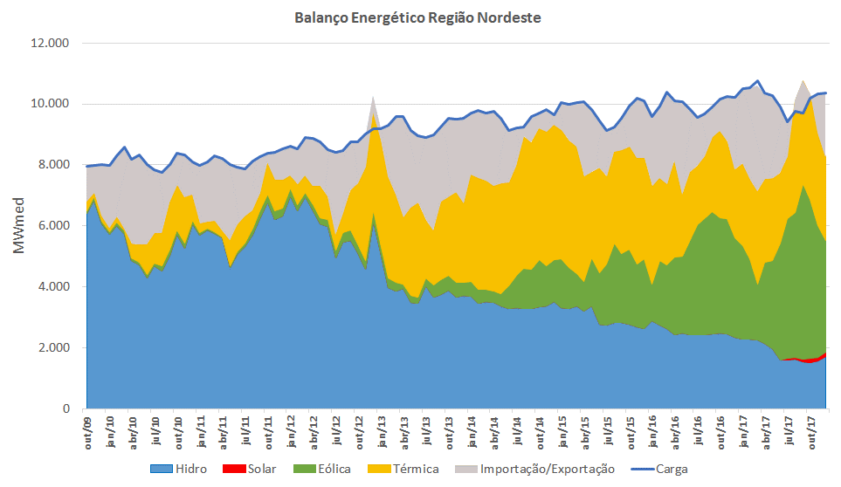

São Francisco Basin
Energy Balance of the Northeast Subsistem
  1.100m³/s
  900m³/s
  800m³/s
  700m³/s
  600m³/s
  550m³/s
Source: ONS, 2017
Hydro
Solar
Wind
Thermoelectric
Interchange
Load

Slide 10
São Francisco Basin
  Sobradinho
  Water storage with management
  Water storage with status quo (defluence = 1.300 m³/s)
  0%VU em NOV/14
Source: ONS, 2017

Slide 11
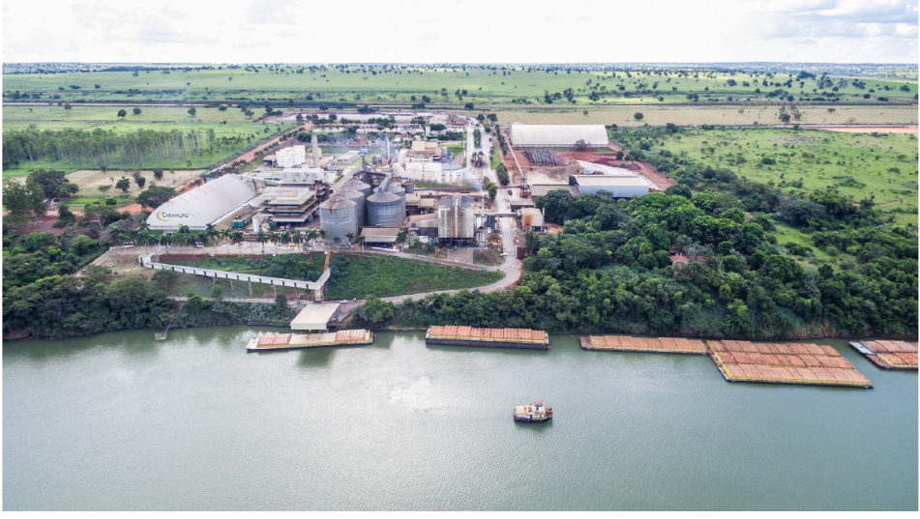
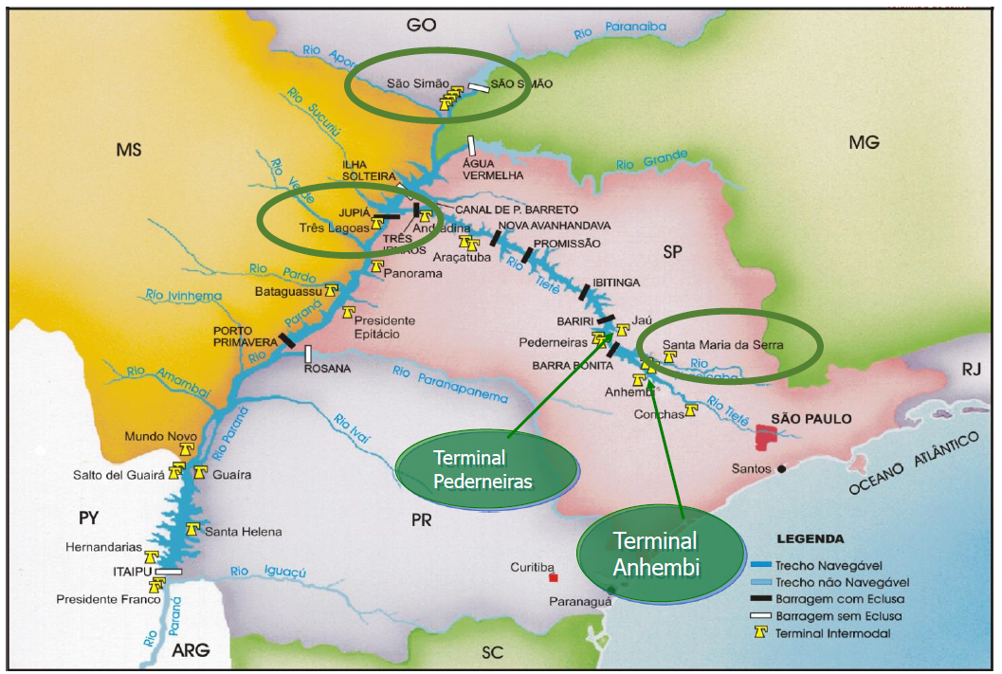
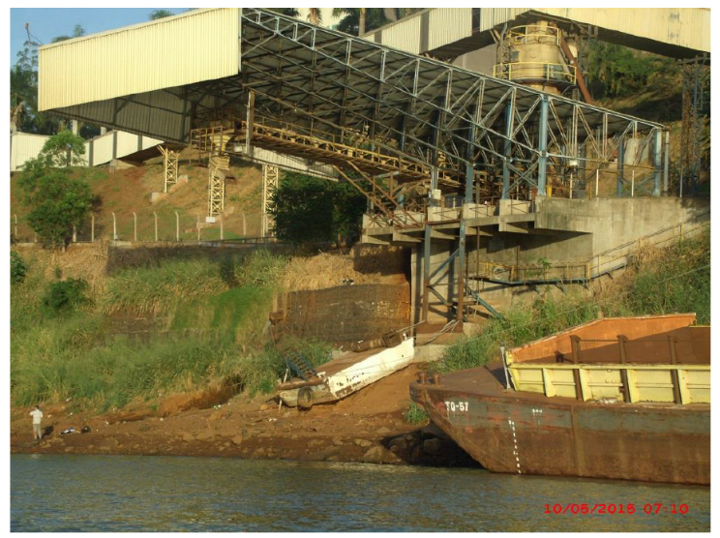
Tietê-Paraná Waterway

Slide 12
Water regulation and water security
Water allocation in droughts
Water reallocation in post-grant
Priority use supply
Users regulation and contracts allow risk mittigation
Mechanisms for water management and regulation should minimize this risk.

Slide 13
Brazil in the next years...
New reservoirs = users together and a consistent regulation
International Agreements in order to decrease greenhouse gases emission
Brazilian socioeconomic growth = more water, transportation, energy, food...
Poverty reduction
Facing extreme weather events
World competitiveness
It’s strategic.

Slide 14
How can we do this?
Brazilian Water Resources Council (CNRH)
Brazilian Energy Policy Council (CNPE)
New design of financing and water allocation in reservoirs
promote articulation between water resources planning and national, regional, state and users sector planning
promote rational use of energy resources

Slide 15

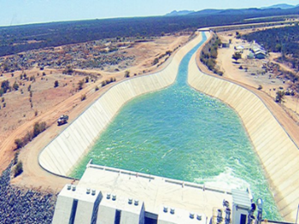
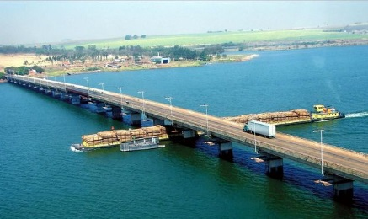
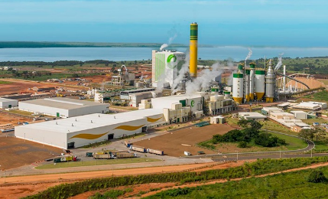
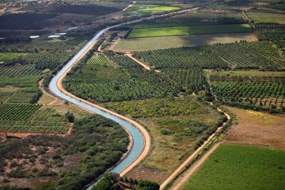
How can we do this?
Institutional framework
Legal and regulatory framework
Sharing water
Strategic Investment

Slide 16
Thank you!
Let’s work together.

Slide 17







Organization
Support

